Slide 1
SVA Design Media Spring
XR Fundamentals

Slide 2
Introduction and Welcome

Slide 3
Syllabus Overview

Slide 4
What is XR?
Virtual Reality?

Slide 5
What is XR?
Virtual Reality?
Augmented Reality??

Slide 6
What is XR?
Virtual Reality?
Augmented Reality??
Mixed Reality???

Slide 7
What is XR?
Virtual Reality?
Augmented Reality??
Mixed Reality???
REALITY?!?!?!?!?!!
Virtual Reality?
Augmented Reality??
Mixed Reality???
REALITY?!?!?!?!?!!

Slide 8
What is XR?
HELP!!!

Slide 9
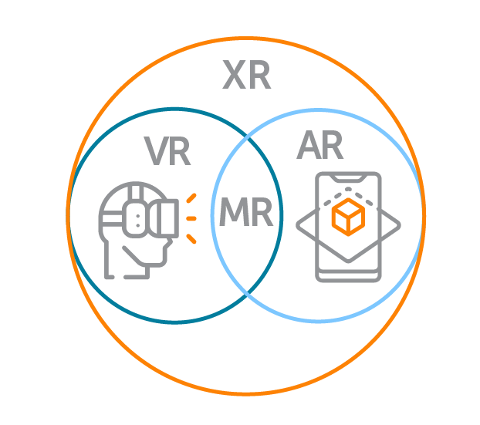
What is XR?

Slide 10
What is XR?
Meta
Quest
HTC Vive

Slide 11
What is XR?
Meta
Quest
HTC Vive
Smartphones

Slide 12
What is XR?
Meta
Quest
HTC Vive
Smartphones

Slide 13
What is XR?
Meta
Quest
HTC Vive
Smartphones
Holo-lens
Apple Vision Pro

Slide 14
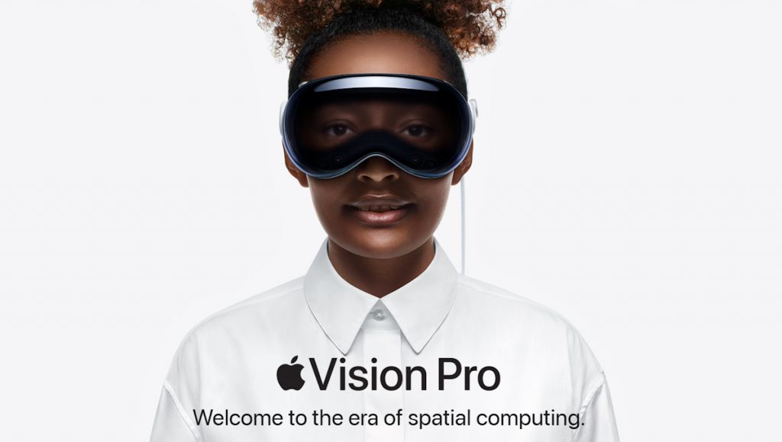

Slide 15
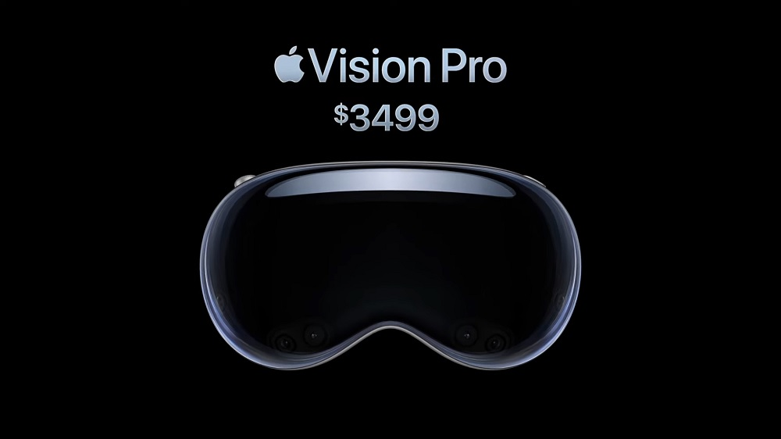

Slide 16
XR From then to Now

Slide 17
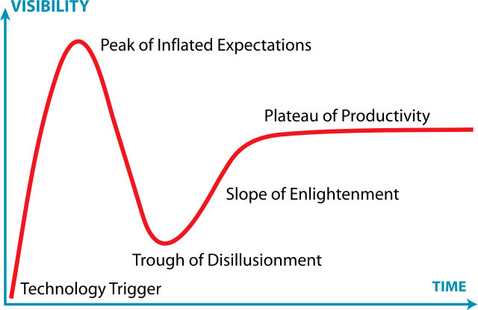
The Gartner Hype Cycle

Slide 18
The Gartner Hype Cycle
t
You are here

Slide 19
The Gartner Hype Cycle
t
You are here
Or maybe here...

Slide 20
The Gartner Hype Cycle
1990
2024
2012
1960

Slide 21
XR From then to Now
Ancient History
Technology Trigger
Peak of Inflated Expectations
The Trough of Disillusionment
The Slope of Enlightenment
The Plateau of Productivity?

Slide 22
Ancient History

Slide 23
Ancient History

